Slide 5
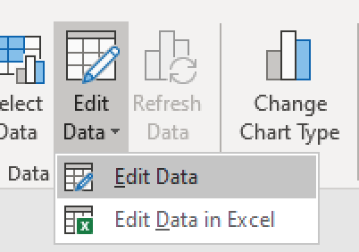
Edit chart data to reflect project

Slide 7
Use this slide for additional information you would
like to share with the Open Space Advisory Board

